Slide 1
LECTURE # 5
METHODS OF PROOF

Slide 2
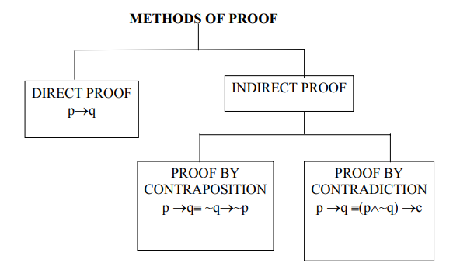
METHODS OF PROOF
INTRODUCTION:
To understand written mathematics, one must understand what makes up a correct mathematical argument, that is, a proof.
This requires an under standing of the techniques used to build proofs. .
Many theorems in mathematics are implications, p → q. The techniques of proving implications give rise to different methods of proofs.

Slide 3
Terminologies
Theorem
A mathematical assertion that can be shown to be true.
Lemma
A theorem used to prove other theorems
Corollary
a proposition that can be proved as a consequence of a theorem that has just been proved
Conjecture
a mathematical assertion proposed to be true, but that has not been proved
a statement that is assumed to be true and that can be used as a basis for proving theorems
Axiom

Slide 4
Understanding How Theorems Are Stated
Example
Many theorems assert that a property holds for all elements in a domain. However, the universal quantifier is often not explicitly stated.
The statement:
“If x > y, where x and y are positive real numbers, then x² > y².”
really means
“For all positive real numbers x and y, if x > y then x² > y².”
That is, in formal logic under the domain of positive real numbers this is the same as ∀x∀y((x > y) → (x² > y² )).

Slide 5
DIRECT PROOF:
A direct proof of p →q is logical valid argument in which we start with the assumption that “P” is true and then using “P” as well as other AXIOMS show directly that “Q” is true.
The implication p →q can be proved by showing that if p is true, on the basis of p , q must also be true.
Such type of proof is called a direct proof.
OR
A formal direct proof of a conditional statement p → q works as follows: assume p is true, build steps using inference rules, with the final step showing the q is true.
Notes:
Direct proved = inference rules

Slide 6
SOME BASICS:
An integer n is even if, and only if, n = 2k for some integer k.
An integer n is odd if, and only if, n = 2k + 1 for some integer k.

Slide 7
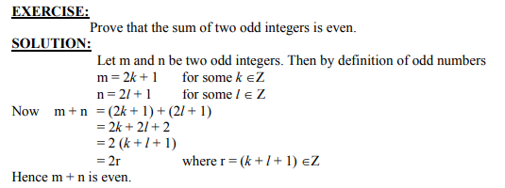
.
*

Slide 8
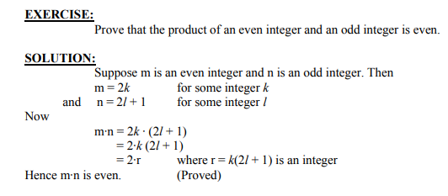
Exercise question

Slide 9
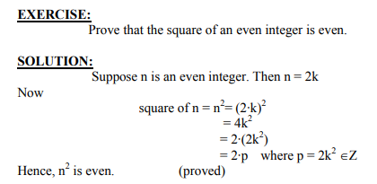
Exercise question

Slide 10
PROOF BY COUNTER EXAMPLE: Disprove the statement by giving a counter example.
EXAMPLE # 1
For all real numbers a and b, if a < b then a^2 < b^2
SOLUTION:
Suppose a = -5 and b = -2 then clearly - 5 < - 2
But a^2 = (-5)^2 = 25 and b^2 = (-2)^2 = 4
But 25 > 4
This disproves the given statement.

Slide 11
PROOF BY CONTRPOSITIVE:
A proof by contraposition is based on the logical equivalence between a statement and its contrapositive. Therefore, the implication p→ q can be proved by showing that its contrapositive ~ q → ~ p is true.
The contrapositive is usually proved directly.
The method of proof by contrapositive may be summarized as:
1. Express the statement in the form if p then q
2. Rewrite this statement in the contrapositive form if not q then not p.
3. Prove the contrapositive by a direct proof.
This method of proof makes use of the equivalence
(p → q) ≡ (¬q → ¬p).

Slide 12
EXERCISE:
Give a proof by contrapositive for the statement: “If n^2 is an Odd integer then n is an odd integer.”
PROOF:
Suppose
P=n^2 is an odd integer
Q= n is odd,
¬P= n = 2k for some integer k(even).
¬Q= n is even.
Now n^2 = (2k )^2 = 4k^2
= 2(2k^2)
= 2r where r = (2k^2 ) ∈Z
This shows that n^2 is even, which is a contrapositive to our supposition is TRUE.
Hence the given statement is true And result hold its property (¬q → ¬p). .
(p → q) ≡ (¬q → ¬p).

Slide 13
PROOF BY CONTRDICTION:
A proof by contradiction is based on the fact that either a statement is true or it is false but not both. Hence the supposition, that the statement to be proved is false, leads logically to a contradiction,
Thus to prove an implication p → q by contradiction method, we suppose that the condition p and the negation of the conclusion q, i.e., (p ∧ ~q) is true and ultimately arrive at a contradiction.
p → q = (p ∧ ~q) FORMULA
Many theorems in mathematics are conditional statements (p→q).
Now the negation of he implication p→q is ~(p→q) ≡ ~(~p∨q)
≡ ~(~p) ∧(~q) DeMorgan’s Law
≡ p ∧ ~q
Clearly if the implication is true, then its negation must be false, i.e., leads to a contradiction.

Slide 14
Example # 1
Prove that “If n is an integer and 3n + 2 is odd, then n is odd.”
P = 3n + 2 is odd
Q= n is odd
(p → q) ≡ (P → ¬Q).
¬Q= n is even def. of even n = 2k
P = 3n + 2 is odd

Slide 15
Solution
Proof:
We prove the statement by contraposition. Assume n is even (assuming ¬q). Then, by definition, n = 2k for some integer k. Thus,
3n + 2 = 3(2k) + 2
= 6k + 2
= 2(3k + 1)
where k’ = 3k + 1, 2(K)
which means 3n + 2 is an even number. This is the negation of the hypothesis of the theorem (¬q), which concludes our proof by contradiction.

